Slide 1

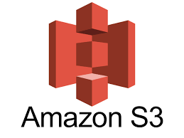

AWS S3(Simple Storage Service)

Slide 2
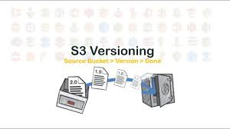
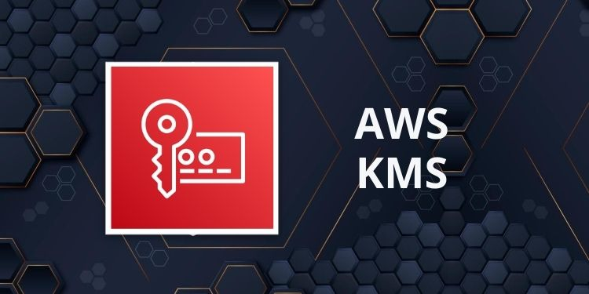
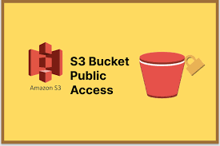
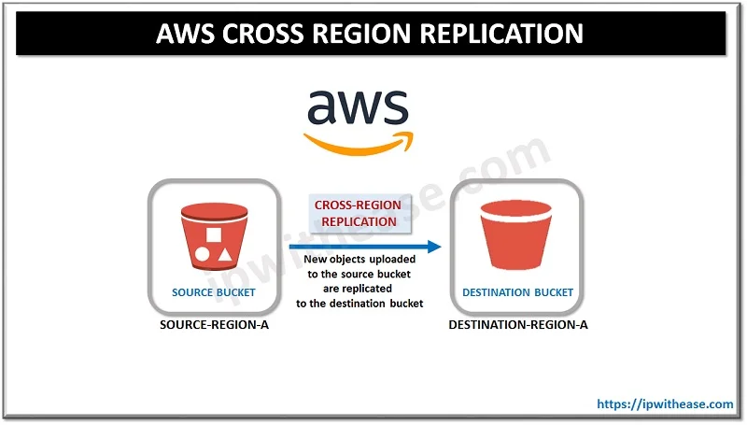
Agenda
Introduction
S3 Versioning
Key Management Service
S3 Bucket Policy
Cross Region Replication

Slide 3

Introduction to S3

Slide 4
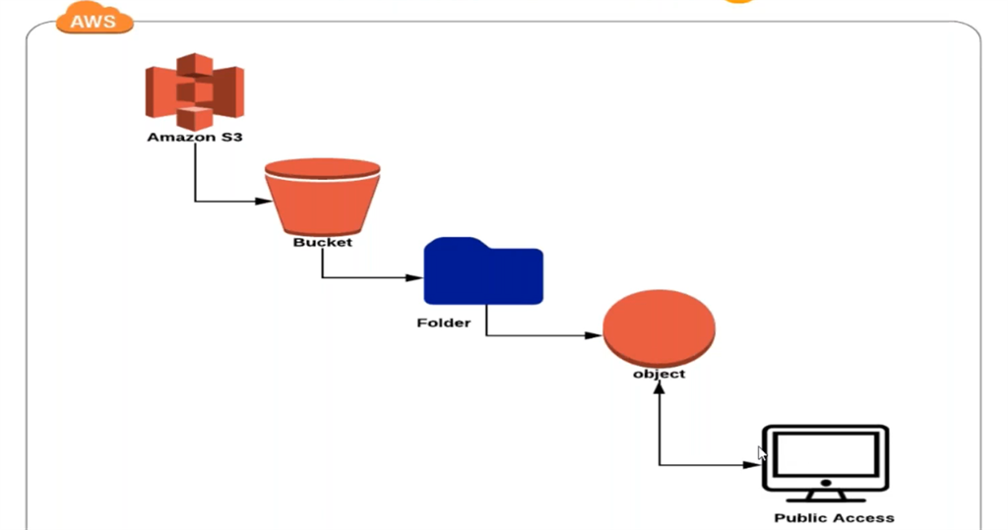
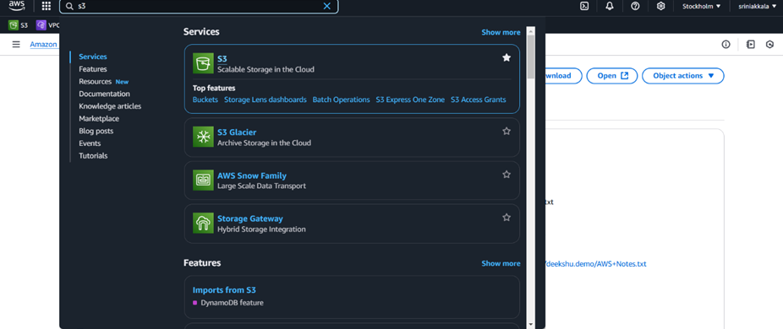
Introduction to S3:
Amazon Simple Storage Service (Amazon S3) is a scalable, highly durable, and secure object storage service offered by AWS. It's designed for developers and businesses to store and retrieve any amount of data from anywhere on the web.
Step 1: Creating an S3 Bucket with versioning
Open AWS Management console

Slide 5
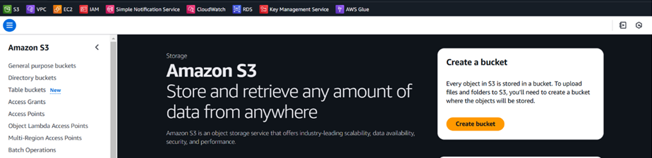
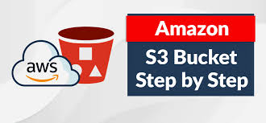
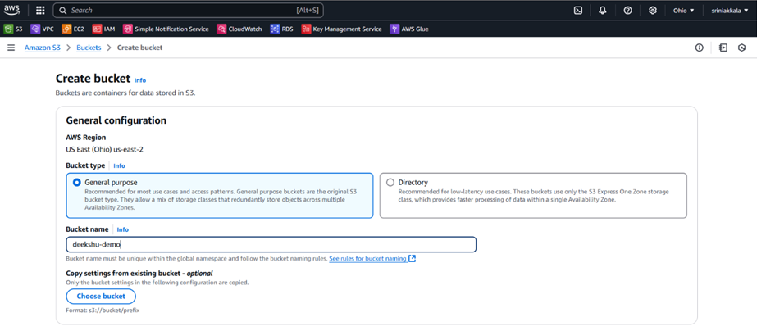
Navigate to the S3 service
To create a new bucket, click the "Create Bucket" button. You will be prompted to provide a unique name for your bucket. This name must be globally unique select the AWS region where it will be created.

Slide 6
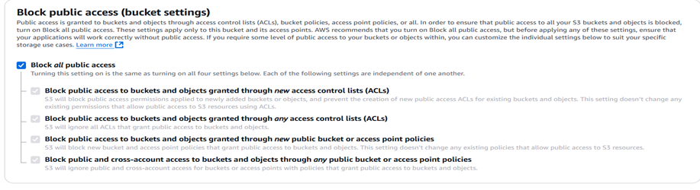
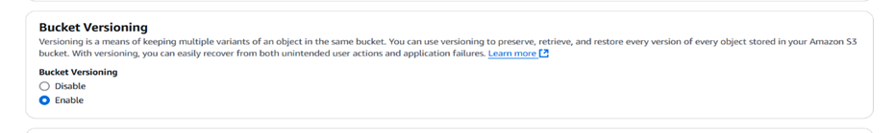
Bucket Creation
Block Public Access Settings enable all options unless public access is required.
Enable versioning to maintain multiple versions of objects.
It is a feature that allows you to maintain multiple versions of an object in a bucket. This is particularly useful for protecting against accidental deletion or overwriting of files.

Slide 7
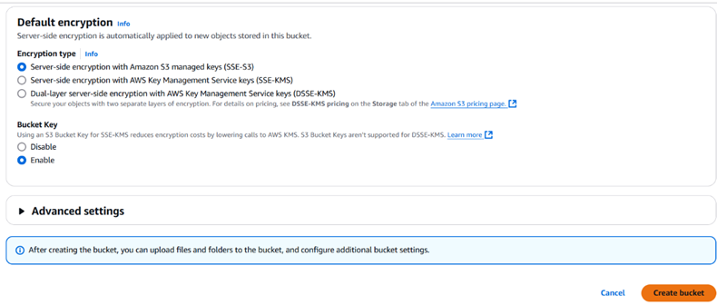
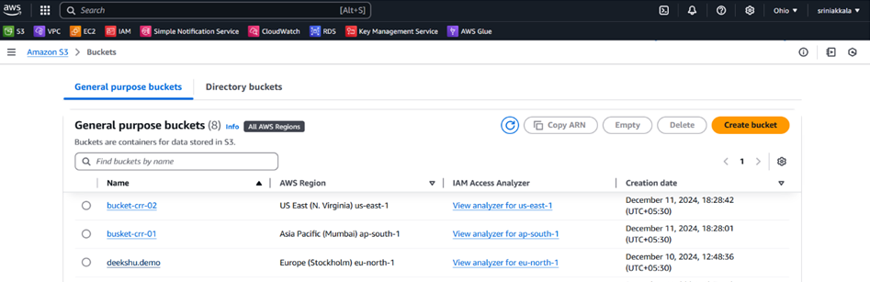
Bucket Creation
Review the settings and click "Create bucket".
After click on Create bucket button it will create your bucket with name deekshu-demo
List of S3 buckets in different regions can be view as below.

Slide 8
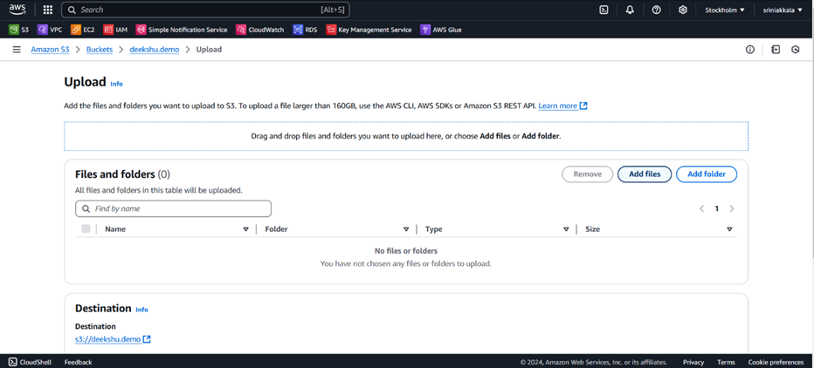
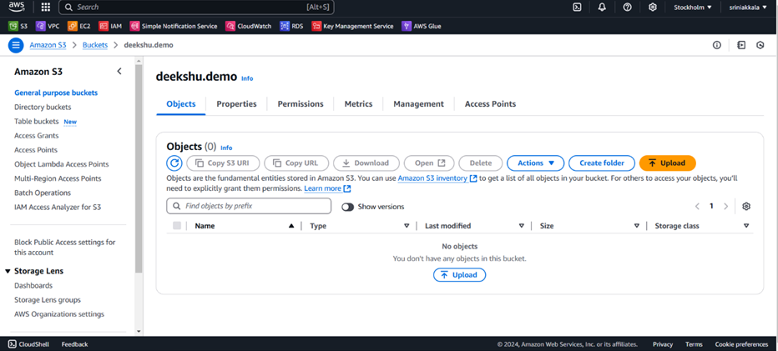
Uploading Files in Bucket
Click on bucket deekshu-demo and it will navigate to inside bucket, where we can upload files as below.
Click on the "Add Files" or "Add Folder" button to browse and select the data you want to upload.
Use the "Upload" button to add files.

Slide 9
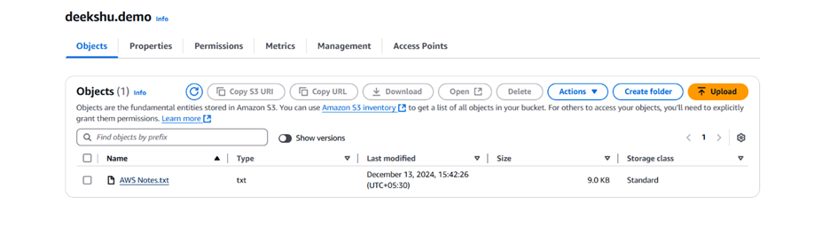
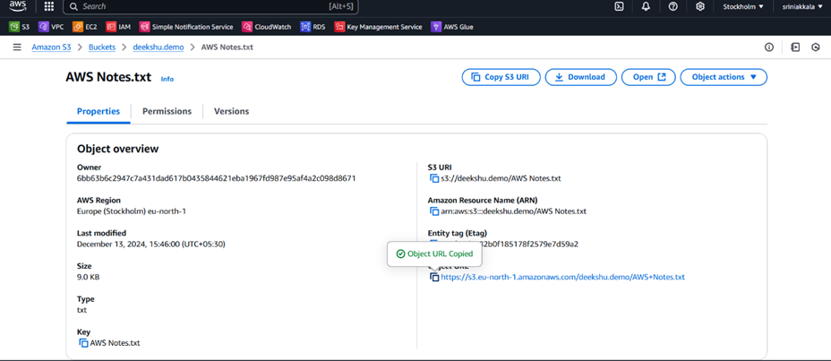
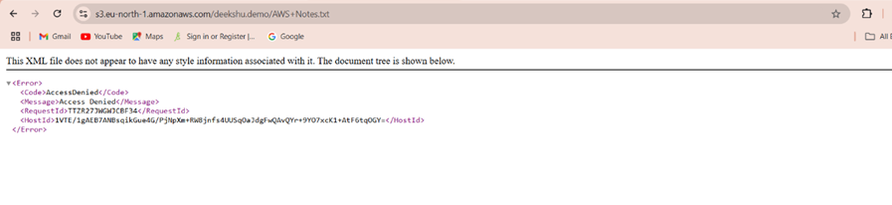
Once upload is successful then you will be navigated back to you bucket with list of files as below
Click on file AWS Notes.txt and here we can see the details of the object uploaded which include Properties, Permissions, and Versions. Note that we can see an Object URL over here. If we copy this URL and paste it into the browser and show data inside the file.
When we attempt to click the Open button in the top-right corner of the S3 console for a file (e.g., index.html), the system generates the Object URL to access the file. However, since public access is blocked (as configured during bucket creation), the request will result in an Access Denied error.

Slide 10
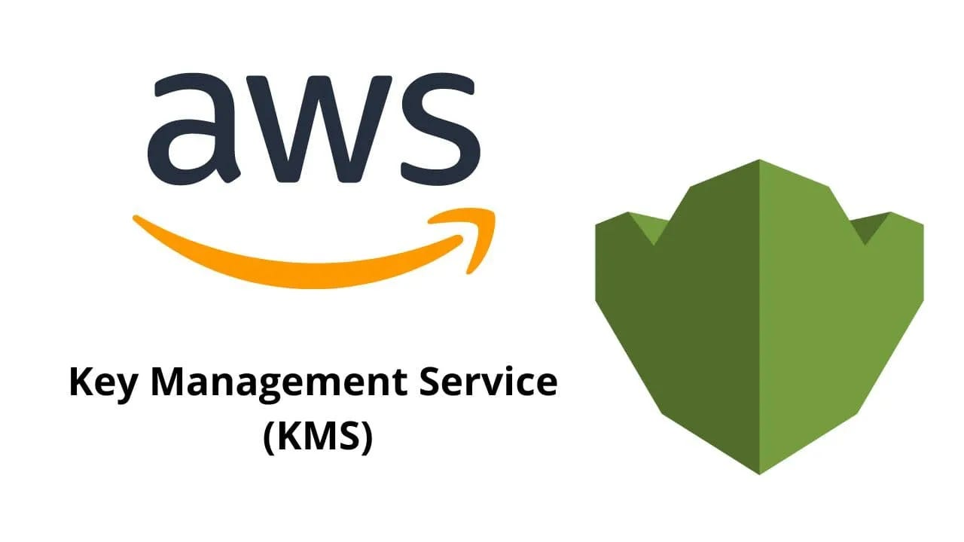
AWS S3 with KMS (Key Management Service)
AWS Key Management Service (KMS) is a managed service that allows you to create and control encryption keys for securing your data. It integrates with many other AWS services to simplify the encryption of your data and management of cryptographic keys.

Slide 11
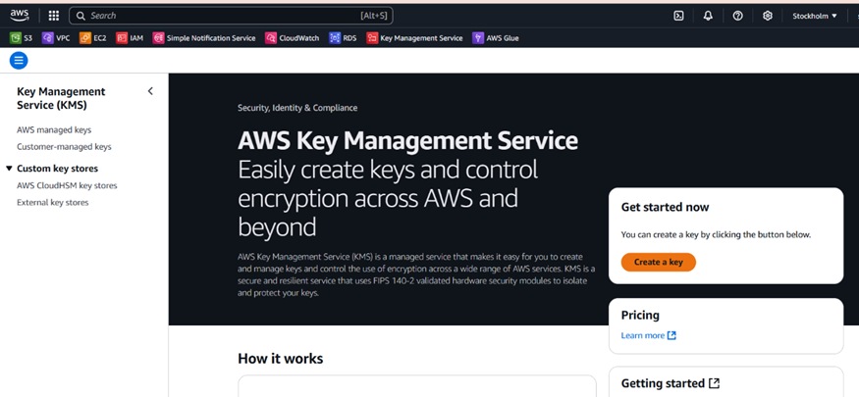
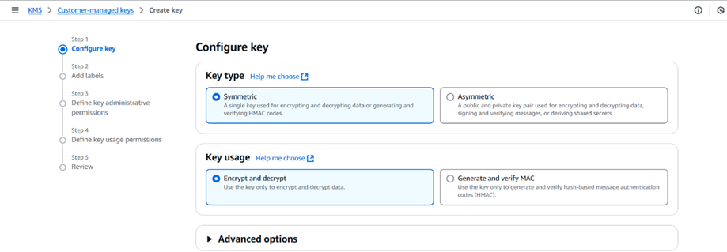
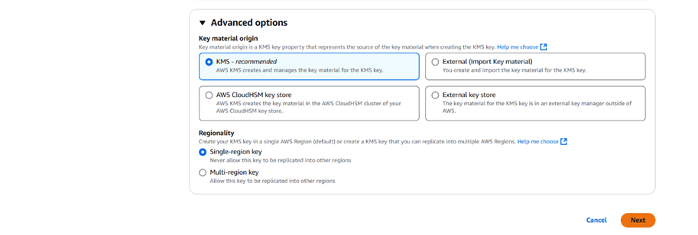
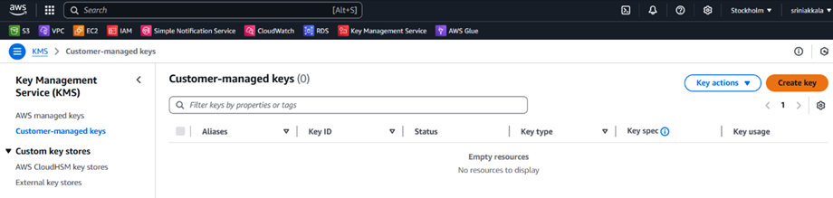
Setting Up AWS KMS
Sign in to the AWS Management Console and Navigate to the AWS KMS Console.
Select the key type:
Symmetric key (most common, used for encryption/decryption).
Asymmetric key (used for signing/verifying or encrypting/decrypting).
Create a Customer-Managed Key. Click on Create key.

Slide 12
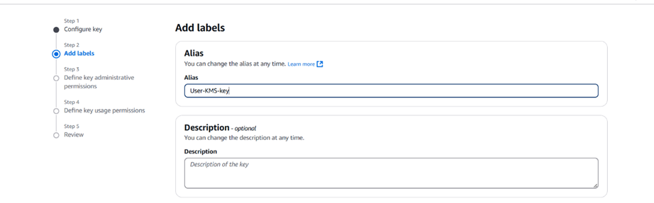
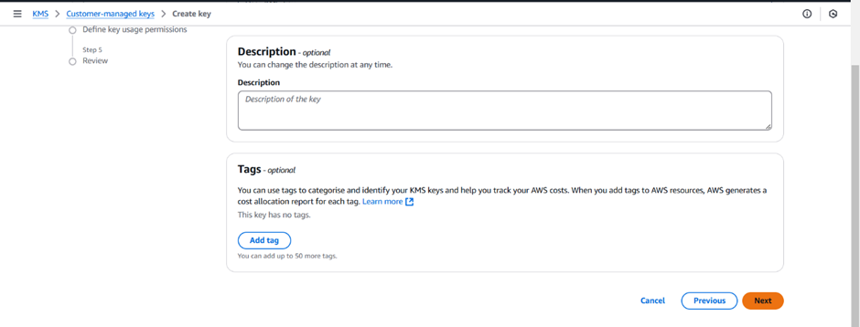
Click on Next and it Navigate to Add labels provide a key alias (a friendly name to identify the key). Click on Next

Slide 13
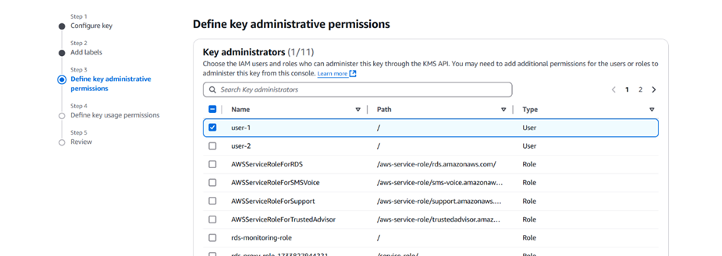
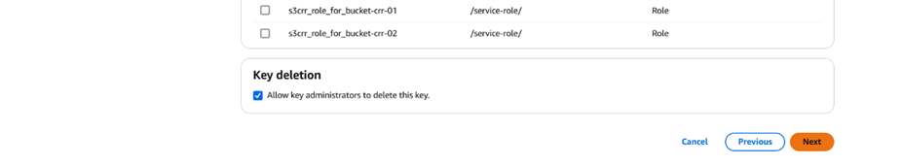
Next Define Key Administrators
Specify which AWS IAM users, groups, or roles can manage this key.
Administrators can perform actions like enabling/disabling keys, modifying key policies, and deleting keys.
Click Next.

Slide 14
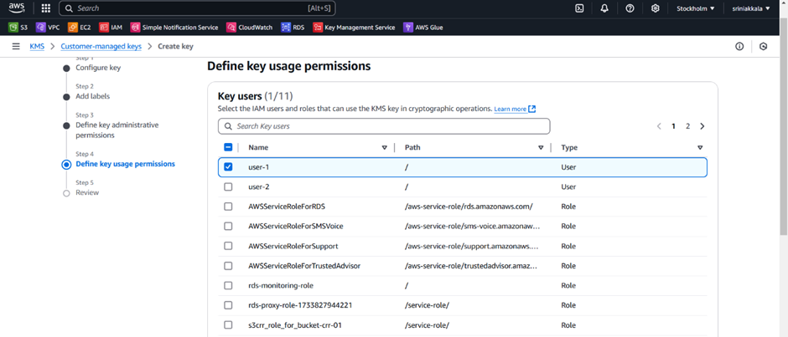
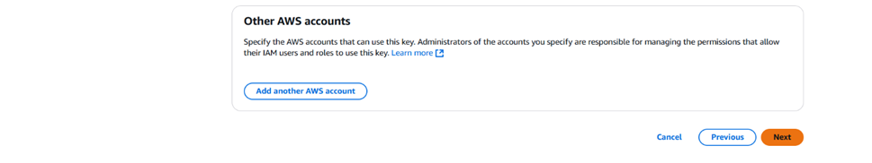
Next Define Key Users
Specify which IAM users, groups, or roles can use the key for encryption or decryption.
Add permissions for services or applications that need access to the key.
Click on Next.

Slide 15
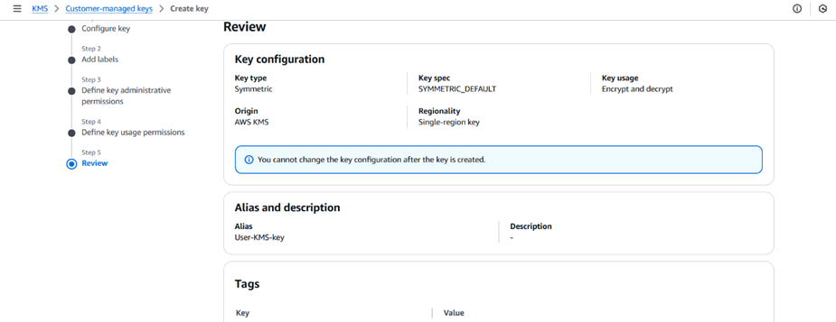
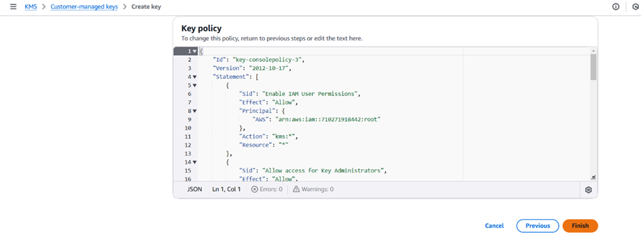
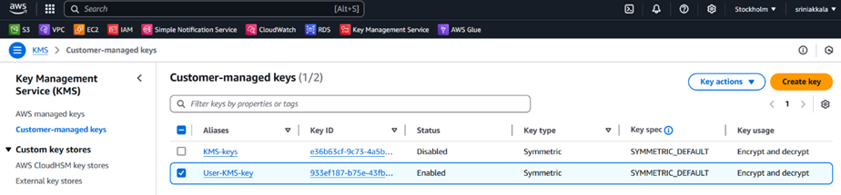
Review all configurations.
Click Finish to create the key.
List of Customer managed keys

Slide 16
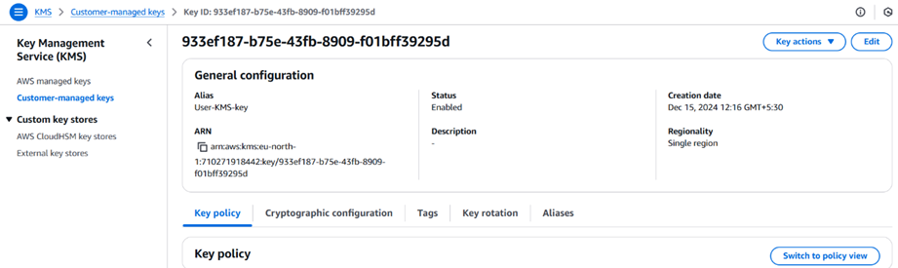
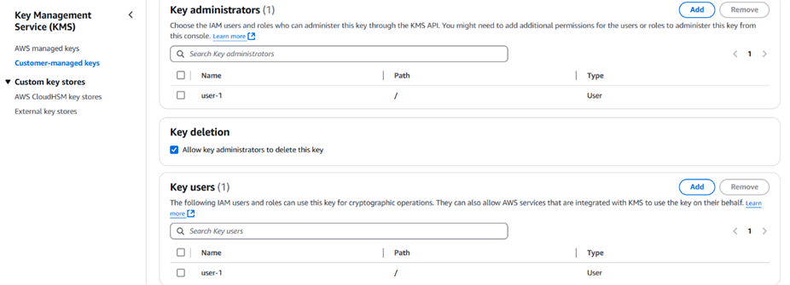
Click on User-KMS-key to navigate to the page where you can view and edit the key details and key policy.

Slide 17
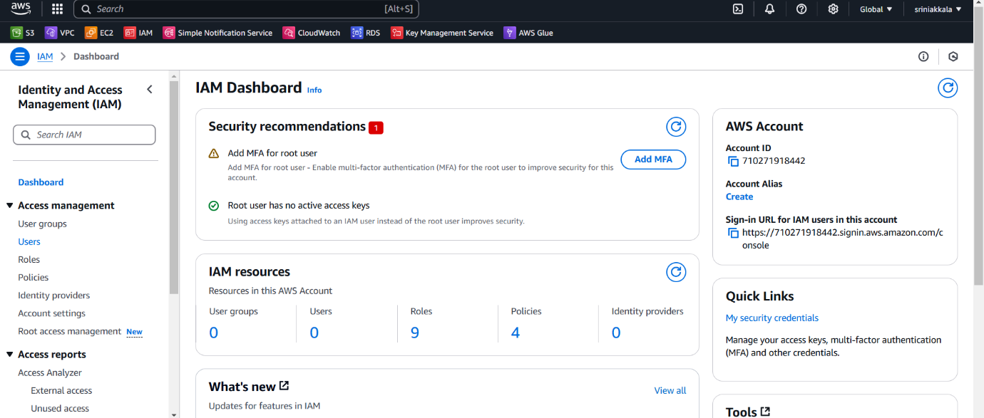
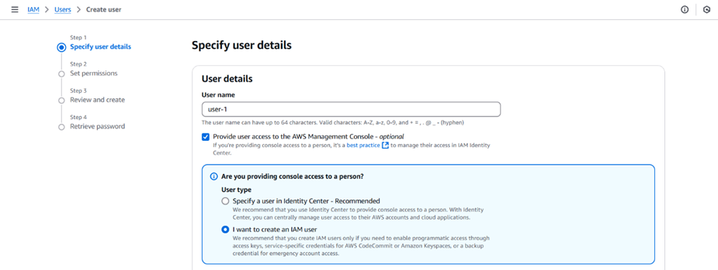
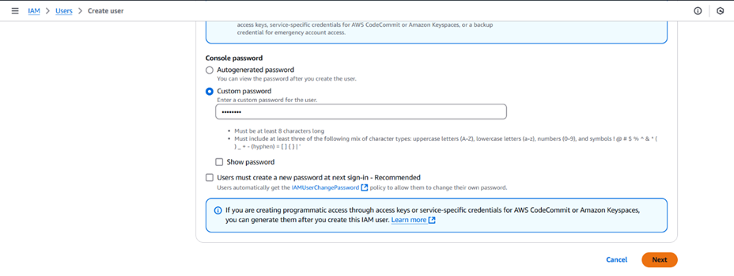
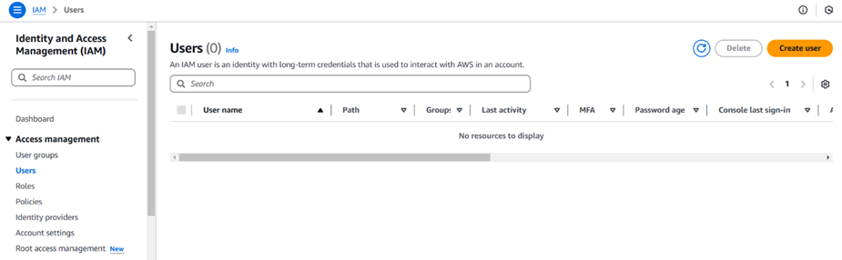
AWS Creation of IAM Users for KMS
We have to create two IAM Users for KMS. Click on Users to create.
Click on Create and Specify user details and select options as shown below. Click on Next.
Creating first IAM user(user-1)

Slide 18
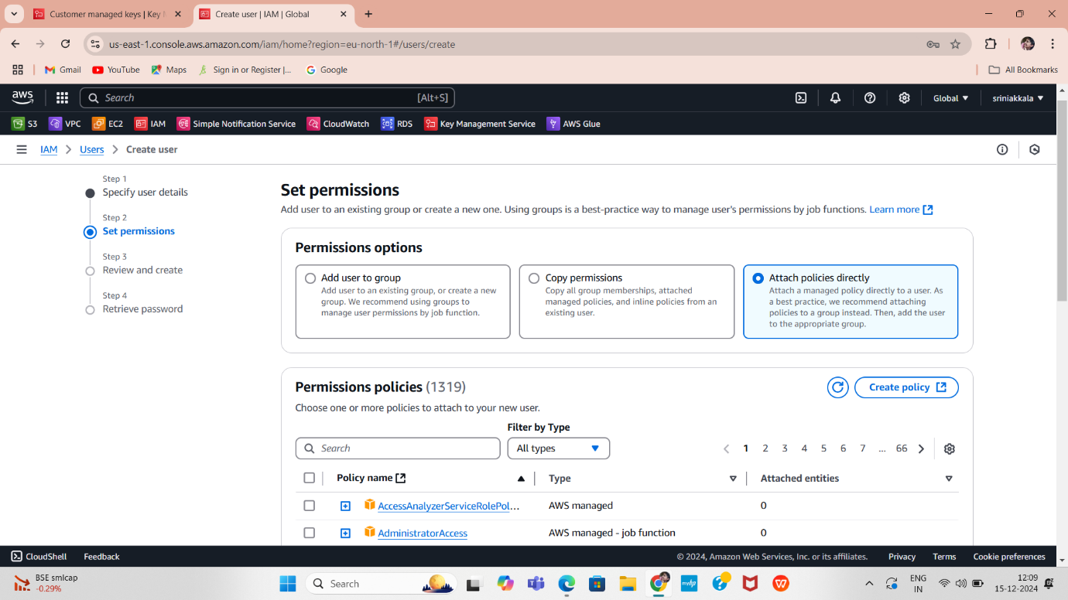
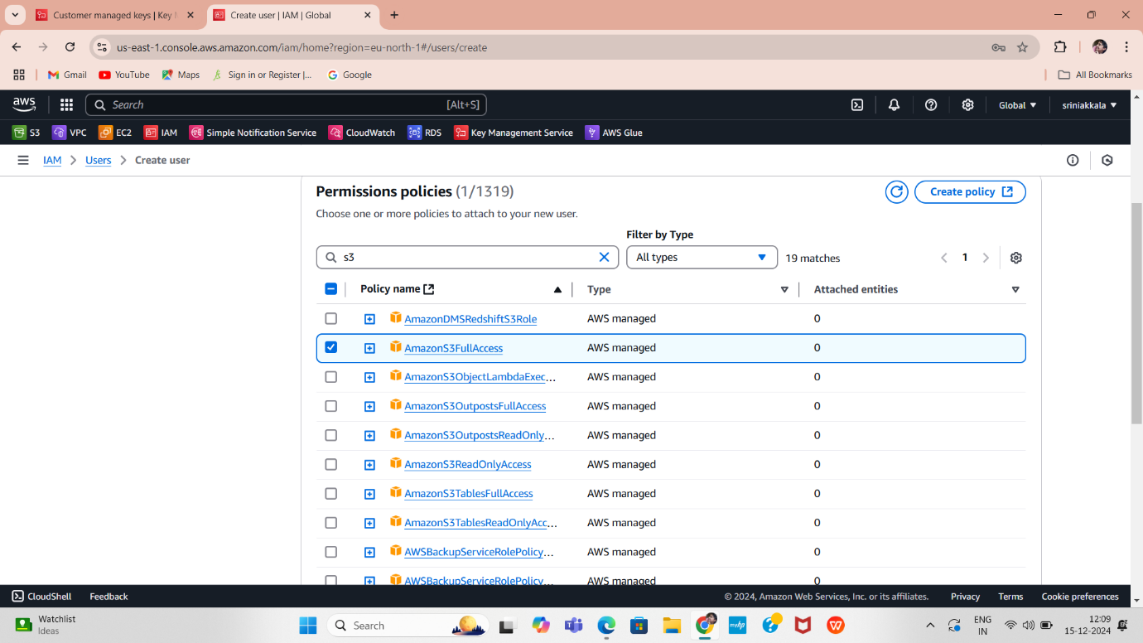
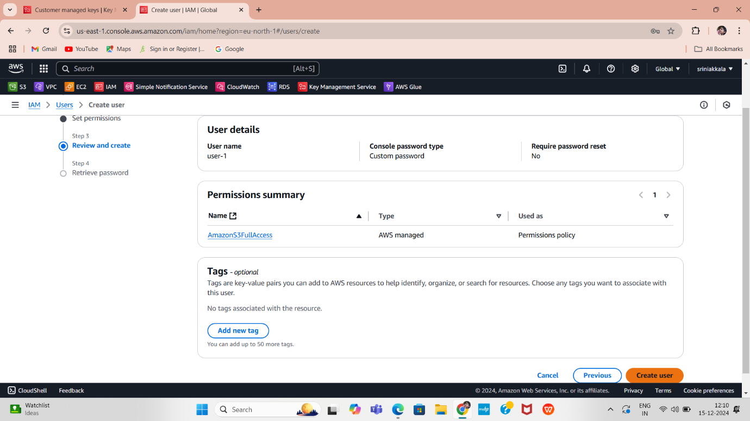
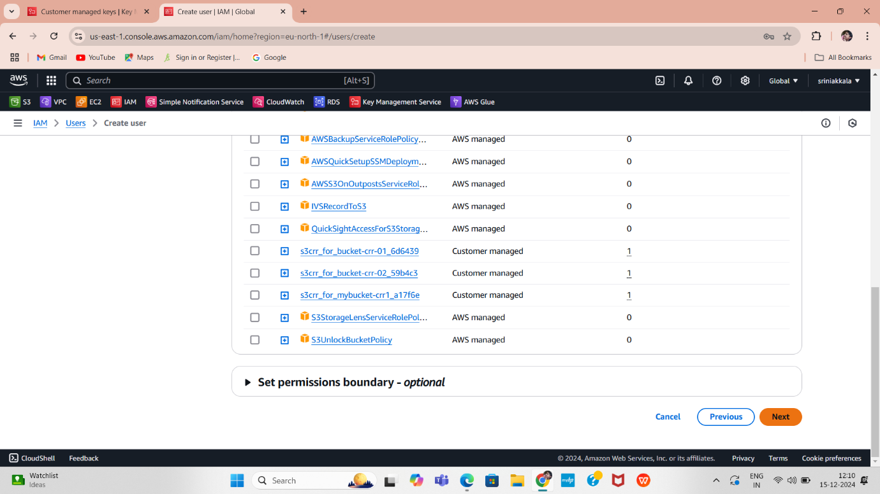
The Set Permissions step in the AWS IAM user creation process allows you to define what actions a user can perform and what resources they can access.
Navigate to "Review and create" to review your selections. After creating the user, you can view and download the autogenerated password if it is enabled. Select the options as shown below, then click on "Create user".
Select options as shown above. Click on Next.

Slide 19
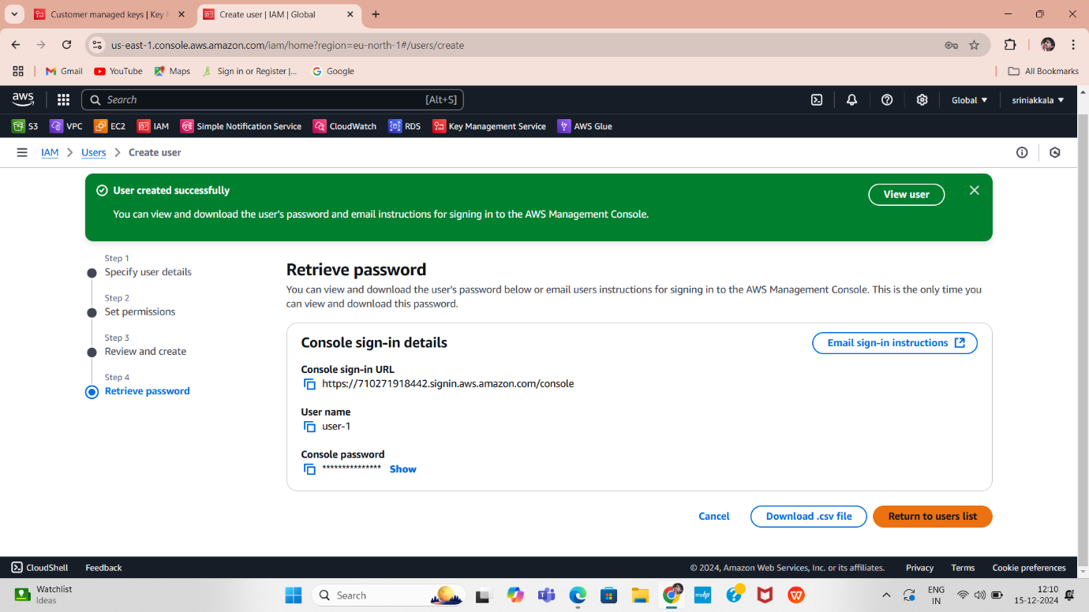
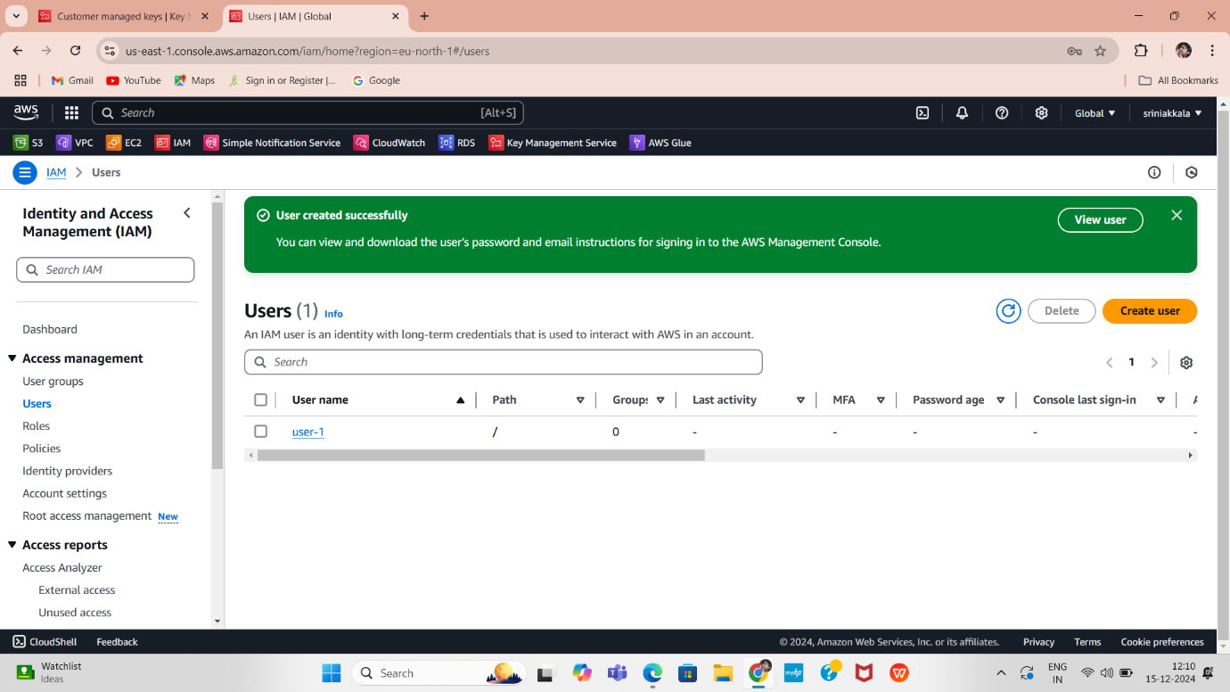
You can only view and download the user's password or email them sign-in instructions by going to the "Retrieve password" section. This is the only time you can access the password.

Slide 20
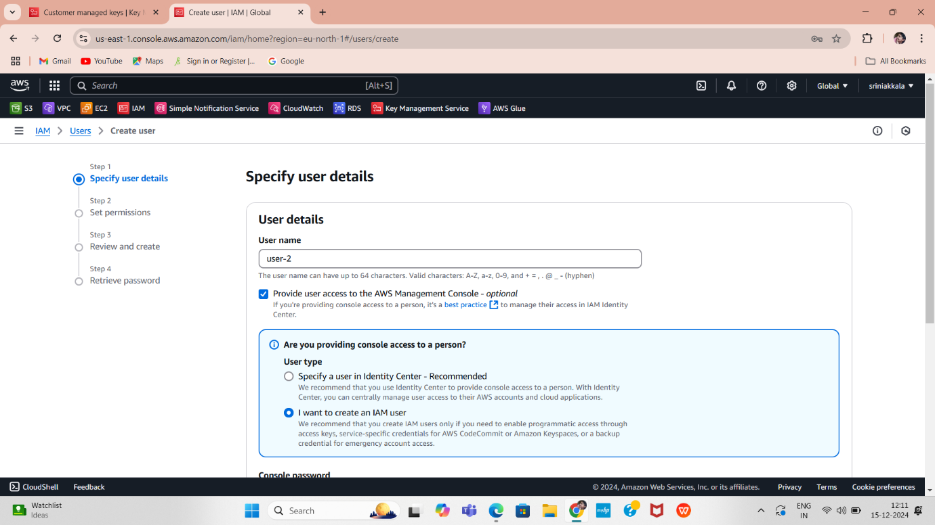
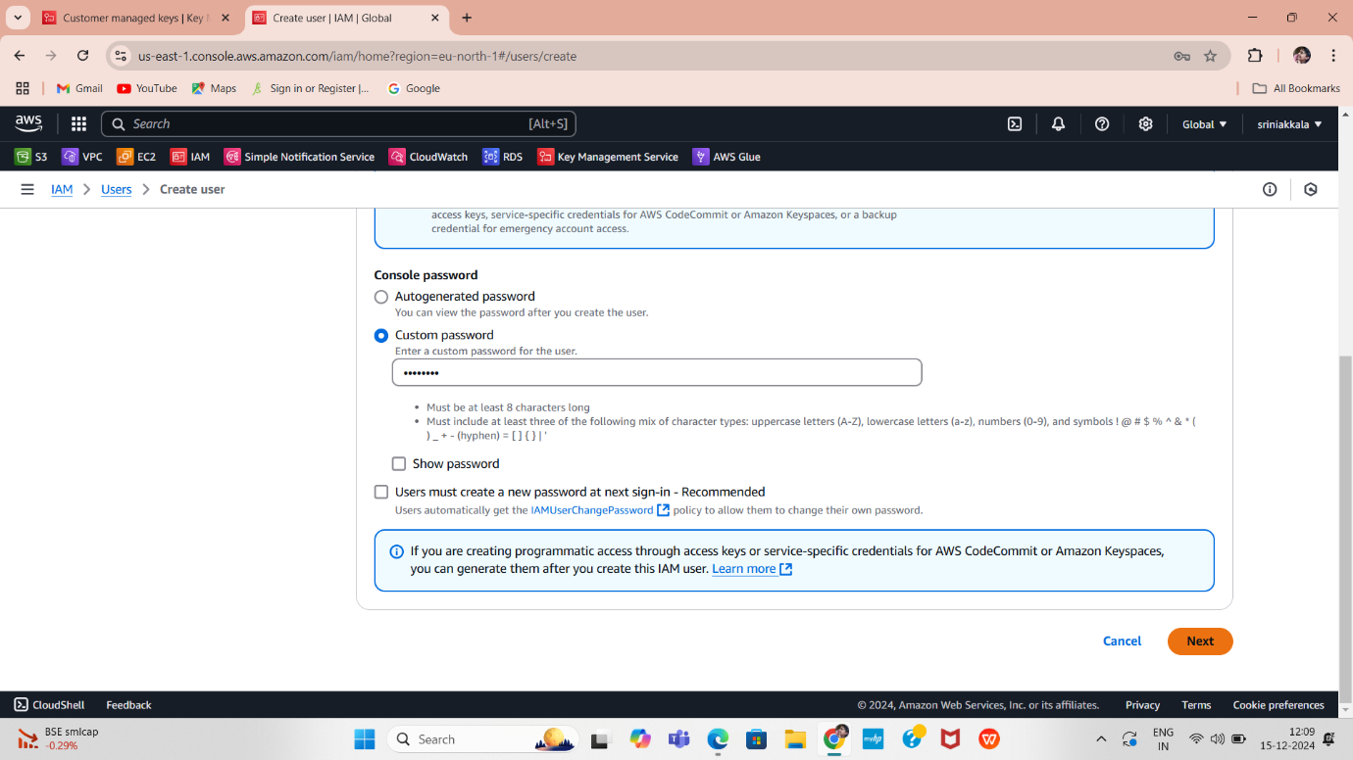
Create second IAM User (user-2)
Click on Create and Specify user details and select options as shown below. Click on Next.
The Set Permissions step in the AWS IAM user creation process allows you to define what actions a user can perform and what resources they can access.
Select options as shown above. Click on Next.

Slide 21
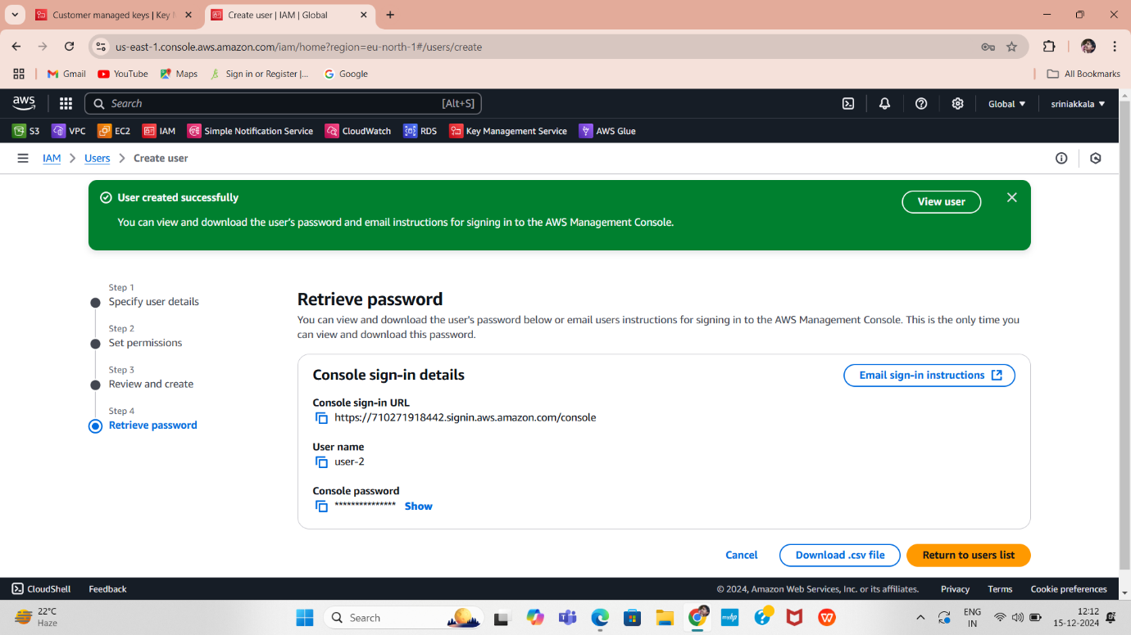
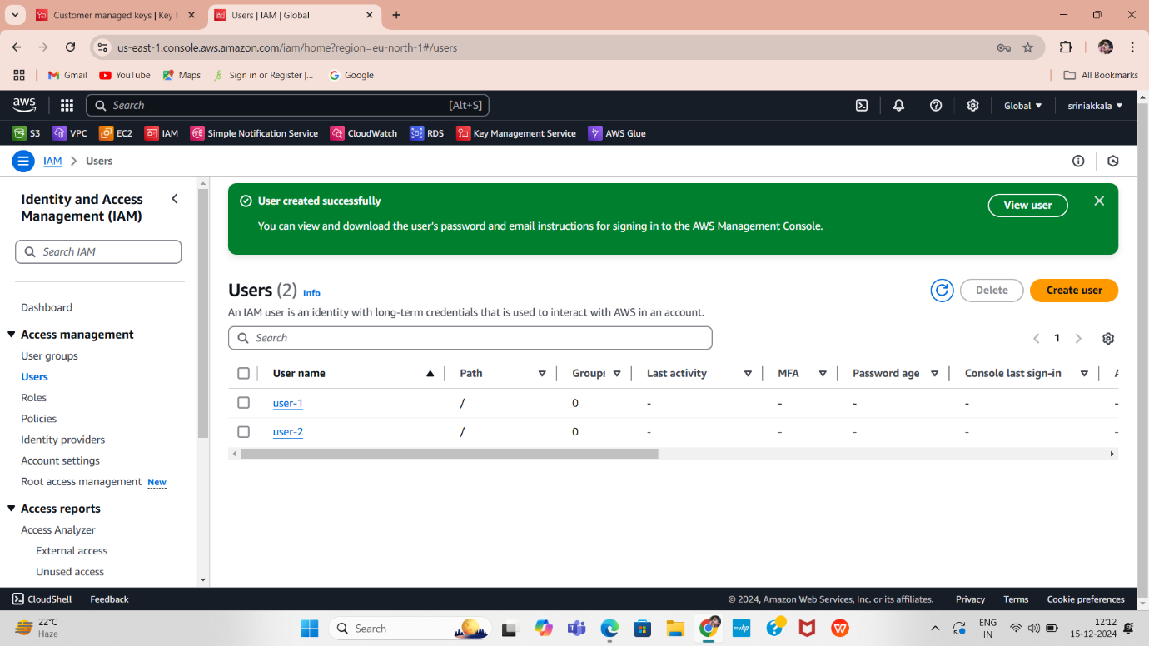
Navigate to "Review and create" to review your selections. After creating the user, you can view and download the autogenerated password if it is enabled. Select the options as shown below, then click on "Create user".
You can only view and download the user's password or email them sign-in instructions by going to the "Retrieve password" section. This is the only time you can access the password.
List of two Users

Slide 22
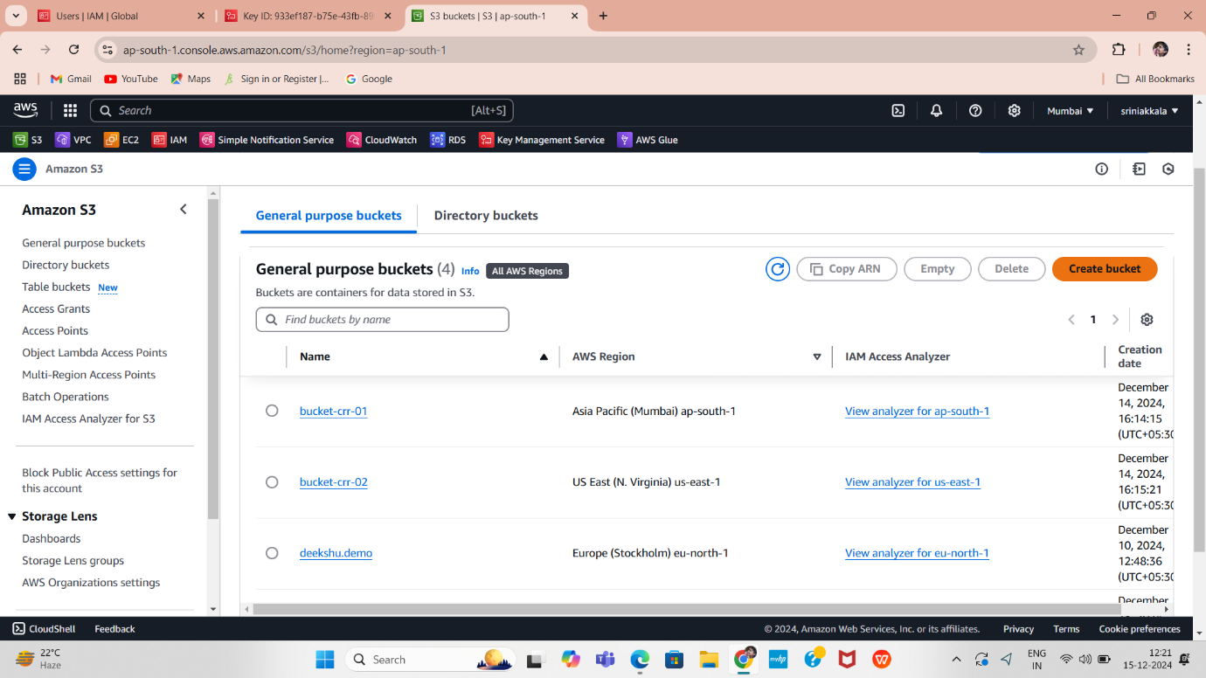


AWS S3 Bucket Creation for KMS
click on "Create Bucket" button. You will be prompted to provide a unique name for your bucket. This name must be globally unique select the AWS region where it will be created.
Here we will navigated to below page, where we can create S3 bucket.

Slide 23



Select "Default encryption" and choose "Server-side encryption with AWS Key Management Service keys (SSE-KMS)." Then, for the "AWS KMS Key," select your desired key from the available AWS KMS keys and choose your custom key. Finally, click on "Create bucket."

Slide 24


List of S3 buckets in different regions can be view as below
Click on the bucket "bucket1-kms," and it will navigate you inside the bucket, where you can upload files as shown below. Click on the Upload button to add files.

Slide 25

Click on "Add files," which will open your local system's file explorer. Select the file you want to upload, and once it's selected, click the "Upload" button.

Slide 26


AWS IAM Users Login Testing KMS
Login with two different IAM user accounts and open the uploaded file in the "bucket1-kms" bucket.
First IAM User Login:
Sign in using the IAM user(uaer-1) credentials, including the username and password.
Click on Sign In.

Slide 27


The IAM user user-1 has permissions for S3 access only. To proceed, click on S3, which will take you to the S3 Dashboard. Select the bucket “bucket1-kms”, Here we can see list of added files. Click on AWS.Notes.txt.
You will be navigated to the info page for AWS Notes.txt. Click on Open. After clicking Open, a new window will appear, displaying the data from the file as shown below.

Slide 28



Second IAM User Login: Sign in using the IAM user(uaer-2) credentials, including the username and password. Click on Sign In.
The IAM user user-1 has permissions for S3 access only. To proceed, click on S3, which will take you to the S3 Dashboard. Select the bucket “bucket1-kms”, Here we can see list of added files. Click on AWS.Notes.txt.

Slide 29

You will be navigated to the info page for AWS Notes.txt. Click on Open. After clicking Open, a new window will appear, displaying the data from the file as shown below.
The IAM user User-2 does not have permissions to access the KMS key.

Slide 30

S3 bucket policies

Slide 31

Creating S3 bucket policies
An Amazon S3 bucket policy is a JSON-based access control policy that allows you to define rules for managing access to your Amazon S3 bucket and its objects. It is used to grant or deny permissions to users, groups, or AWS services.
Select the bucket for which you want to create or modify the policy.

Slide 32


Select the bucket deekshu-demo, navigate to the Permissions section, and ensure that Block public access is turned off.

Slide 33


Create S3 bucket policy: In the Permissions section of the bucket, you will notice that no policy is currently applied to the bucket. Click on Edit to add a bucket policy.
Once you click Edit, you will be taken to a screen where the Bucket ARN (Amazon Resource Name) is displayed. The Bucket ARN uniquely identifies your S3 bucket and is required for creating a bucket policy. We will use this ARN in the next step to generate the policy using the Policy Generator tool.
To proceed, click on Policy Generator

Slide 34



In the Policy Generator, you can define policies to control access to AWS resources. Start by selecting the Policy Type, which in this case is S3 Bucket Policy. Note that you can also create other policy types, such as IAM Policy, SNS Topic Policy, VPC Endpoint Policy, or SQS Policy. Next, add a Statement to define permissions: Effect: Select Deny. Principal: Enter * (all users). Actions: Select PutObject and DeleteObject. Amazon Resource Name (ARN): Enter the Bucket ARN from the previous screen and append /* to it. Click Add Statement to add this rule.
Click Generate Policy to create the policy

Slide 35


The Policy Generator returns a JSON document that represents the S3 Bucket Policy. This JSON policy can be directly copied and applied to your S3 bucket. The Policy Generator simplifies the process of creating policies, making it easier to define access controls for your bucket. Now, copy the generated JSON document and paste it into the Bucket Policy section of your S3 bucket. After pasting the policy, click Save changes.

Slide 36


Shows Successfully edited bucket policy. Test the Policy: Test the bucket policy by attempting actions that the policy denies. Now, navigate back to the bucket(deekshu-demo), select AWS Notes.txt, and try to Upload file and Delete file.

Slide 37


Try uploading a file to the bucket to verify if the policy allows or denies this action.
Attempt to delete the file to check if the delete action is permitted or restricted by the bucket policy.

Slide 38

S3 Cross Region Replication
Cross Region Replication

Slide 39

S3 – Cross Region Replication
With cross-region replication, every object uploaded to an S3 bucket is automatically replicated to a destination bucket in a different AWS region that you choose. For example, you can use cross-region replication to provide lower-latency data access in different geographic regions.
Two S3 Buckets:
A source bucket (where the files are uploaded).
A destination bucket (where files will be replicated).
Create Source Bucket:
Go to AWS console and click on create bucket in Mumbai Region(ap-south-1).
Click Create bucket

Slide 40



Provide a unique name bucket-crr-01 and choose a region(Mumbai Region(ap-south-1).
Enable Versioning during creation
Click on create bucket button.

Slide 41



Create Destination Bucket: Repeat the steps to create a second bucket bucket-crr-02 in a different region (N. Virginia region(us-east-1)).
Enable Versioning
Click on create bucket button.

Slide 42



Here are the two buckets which we created in two different regions, above are the list of buckets. Configure Replication Rules: Go to the Source Bucket bucket-crr-01(Mumbai region) select the bucket. Enable Replication: Navigate to Management → Replication rules → Create replication rule.

Slide 43



Click on create replication rule, create the rule.
Create replication rule here by giving name and set rule scope – Apply to all objects in the bucket.

Slide 44



Select the destination bucket by choosing either "A bucket in this account" or "Browse S3" to locate and select the desired bucket where you want to replicate your files. After selecting the destination bucket, click Save.
Choose the path of Destination bucket bucket-crr-02.Click on Choose path

Slide 45




Choose IAM role by Clicking on Create new role.
Click o save.
After clicking Save, a popup appears with the option to Replicate existing objects. Select No, do not replicate existing objects, and Submit.

Slide 46



Redirect to a page Buckets select SourceBucket(bucket-crr-01).
Upload a test document (AWS notes.txt) to the source bucket (Mumbai region) add file and upload.

Slide 47

Destination Bucket
Check Destination Bucket:
Verify the replicated file appears in the destination bucket(bucket-crr-02) in N. Virginia region after a few minutes.
With these steps, you can successfully set up S3 Cross-Region Replication to replicate objects between buckets in different AWS regions, improving durability, disaster recovery, and performance.

Slide 48
Thank you
G.DEEKSHITHA

